Slide 1
Design and Analysis of Algorithm s 1. Introduction
By
Dr Rafiullah Khan
Senior Lecturer ICS/IT
The University of Agriculture Peshawar, Pakistan
For resources, please visit: https://rafiyz.github.io/courses/Algorithms/algo.htm

Slide 2
Agenda for Week 1
Introduction to Algorithms
What is an Algorithm?
Characteristics of Algorithms
Examples of Algorithms
Analysis of Algorithms
Why Analyze Algorithms?
Time Complexity
Space Complexity
Big O Notation

Slide 3
What is an Algorithm?
A step-by-step procedure for solving a problem or performing a task.
Algorithms can be expressed in many ways:
Natural Language
Flowcharts
Pseudocode
Real-world examples:
Sorting numbers
Finding the shortest path in a map

Slide 4
Characteristics of a Good Algorithm
Correctness: Does it solve the problem?
Efficiency: How well does it perform?
Finiteness: It should stop after a finite number of steps.
Determinism: Given the same input, it produces the same output.
Clarity: It should be easy to understand and implement.

Slide 5
Types of Algorithms
Divide and Conquer: Break down the problem into smaller sub-problems (e.g., Merge Sort).
Greedy Algorithms: Make the best choice at each step (e.g., Dijkstra’s Algorithm).
Dynamic Programming: Solve complex problems by breaking them into simpler sub-problems (e.g., Fibonacci sequence).
Backtracking: Try possible solutions and backtrack if a solution doesn’t work (e.g., N-Queens Problem).

Slide 6
Why Analyze Algorithms?
Performance Evaluation: To compare different algorithms.
Optimization: Find the most efficient solution.
Predicting Behavior: How does the algorithm perform with increasing input size?
Resource Management: Understand time and space requirements.

Slide 7
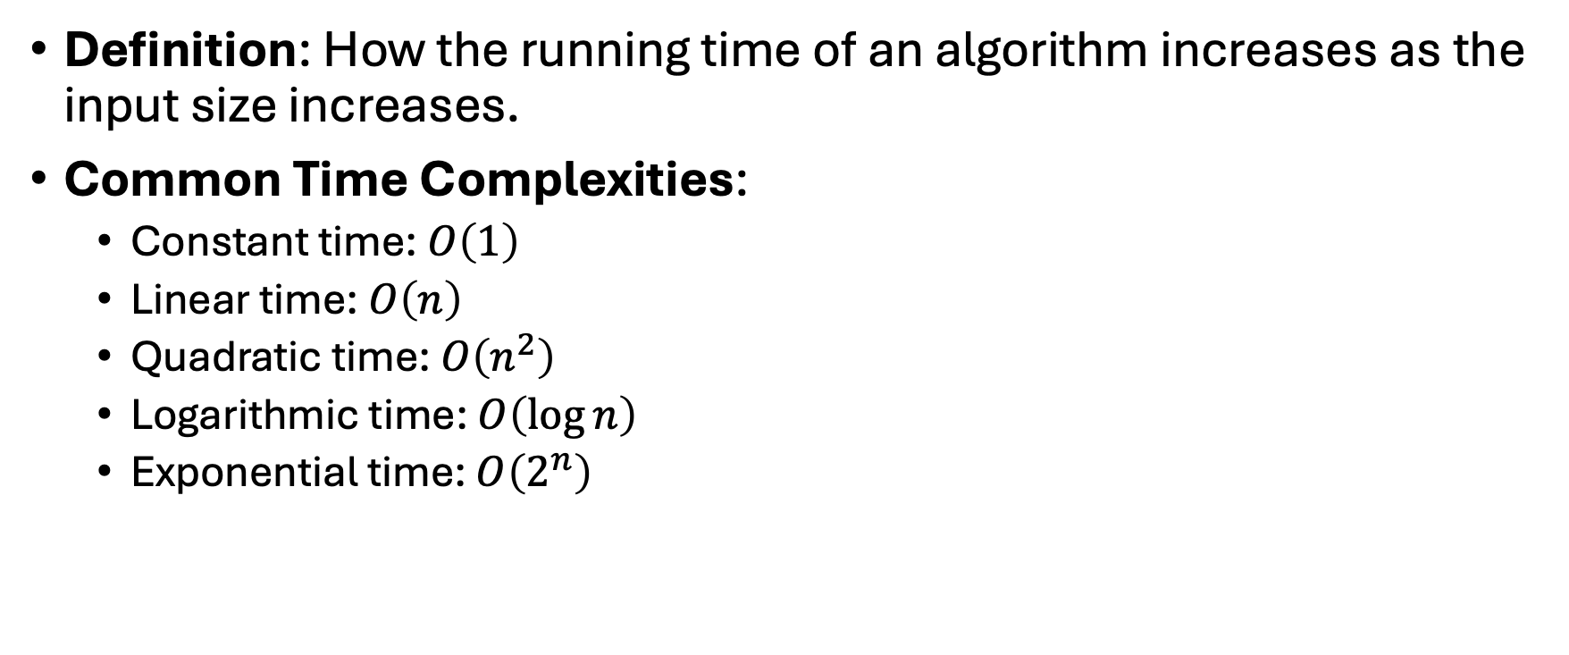
Time Complexity
Definition: How the running time of an algorithm increases as the input size increases.
Common Time Complexities:
Constant time: $O\left(1\right)$
Linear time: $O\left(n\right)$
Quadratic time: $O\left(n^{2}\right)$
Logarithmic time: $O\left(\log{n}\right)$
Exponential time: $O\left(2^{n}\right)$

Slide 8
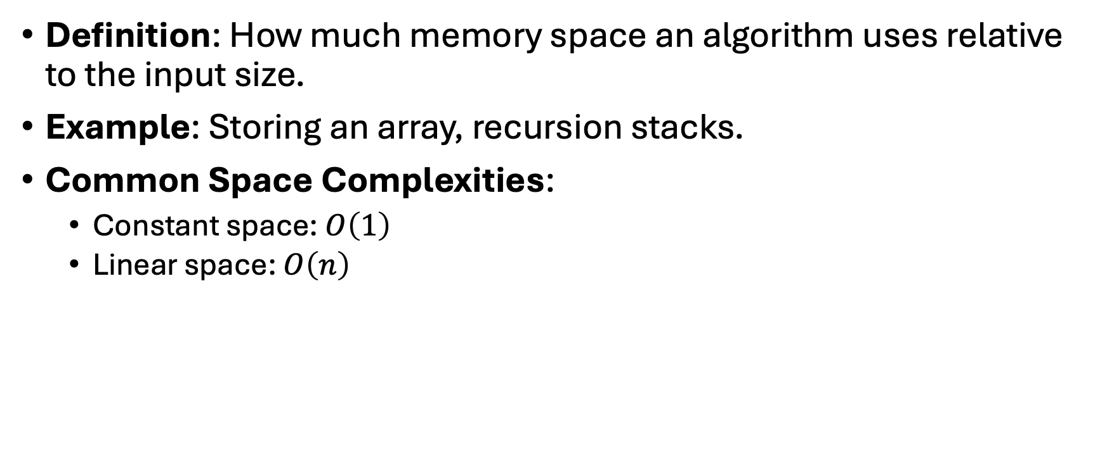
Space Complexity
Definition: How much memory space an algorithm uses relative to the input size.
Example: Storing an array, recursion stacks.
Common Space Complexities:
Constant space: $O\left(1\right)$
Linear space: $O\left(n\right)$

Slide 9

Big O Notation
Big O is used to classify algorithms based on their growth rate.
Examples:
$O\left(1\right)$→ Constant time complexity.
$O\left(n\right)$→ Linear time complexity.
$O\left(n^{2}\right)$→ Quadratic time complexity.

Slide 10
Analyzing an Algorithm: Example
#include <stdio.h>
int main()
{
printf("Hello, my name is Al-Khawarizmi!\n");
printf(”I am the father of Algorithms");
return 0;
}

